Slide 1
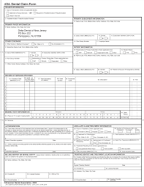


Resolving Dental Claims
By:
Sankalp Chauhan (Sonny)

Slide 2




Goal
Create a machine learning model using SQL that is able to predict the probability of a new claim getting accepted/rejected
1. Determine the reasons of a claim rejection
2. We want to find where in the data corresponds with the rejected reasons for the claim so that I will be able to incorporate that into the model

Slide 3
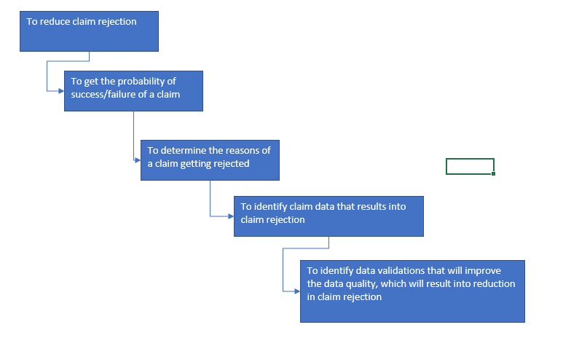
Claim Rejection diagram

Slide 4
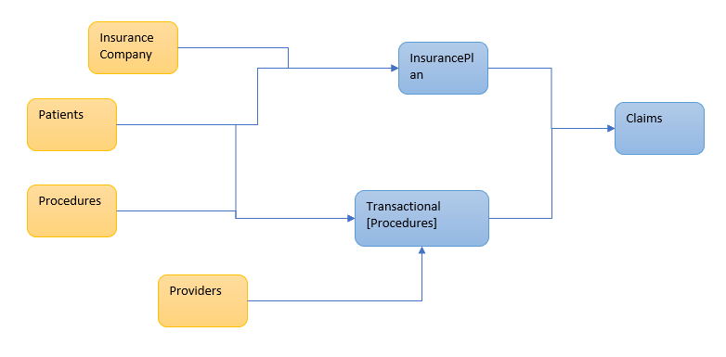
ER Diagram

Slide 5
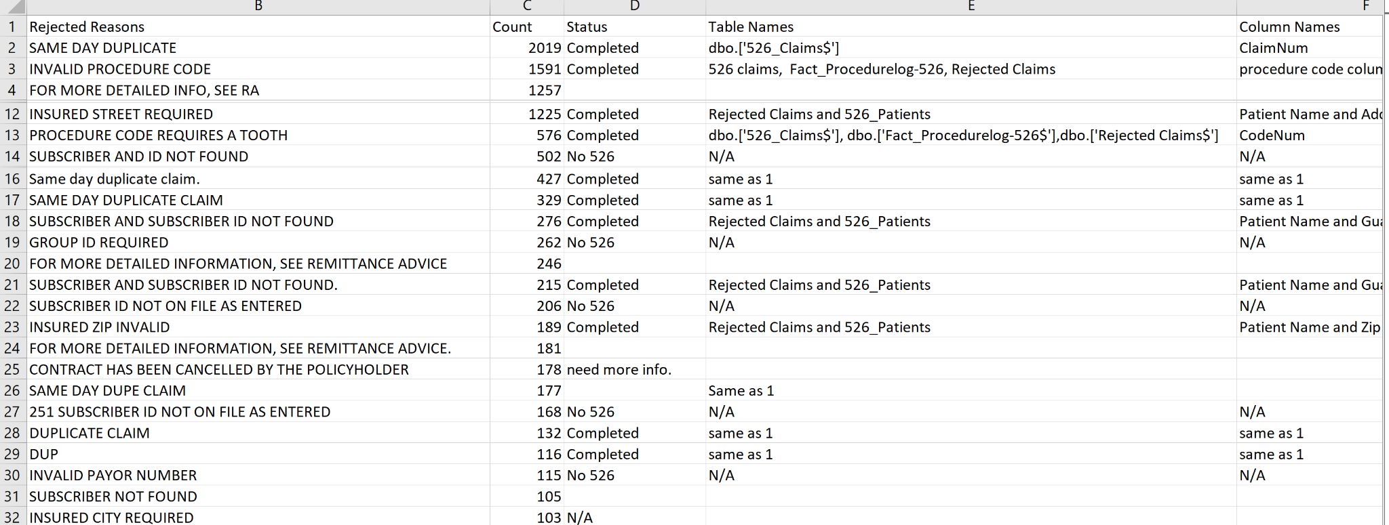
Rejected Claims Data that have more than 100 hits
Excel file of rejected claims that have over 100 hits.

Slide 6
Reasons of Rejection
Duplicate Claims
Invalid Procedure Code
Insured Street Require
Procedure Code requires a tooth
Subscriber and Subscriber ID not found
Insured zip invalid

Slide 7


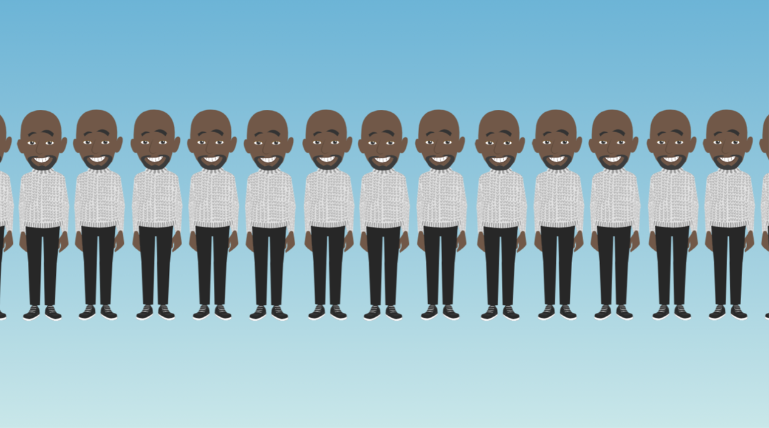

Duplicate Claims
Claim data that results in claim rejection:
See the different claim numbers in dbo.[‘526_Claims’]
If two claims have the same ClaimNum then they are duplicate claims
SELECT ClaimNum,Count(*)
FROM dbo.['526_Claims$']
GROUP BY ClaimNum
HAVING Count(*)>1;

Slide 8
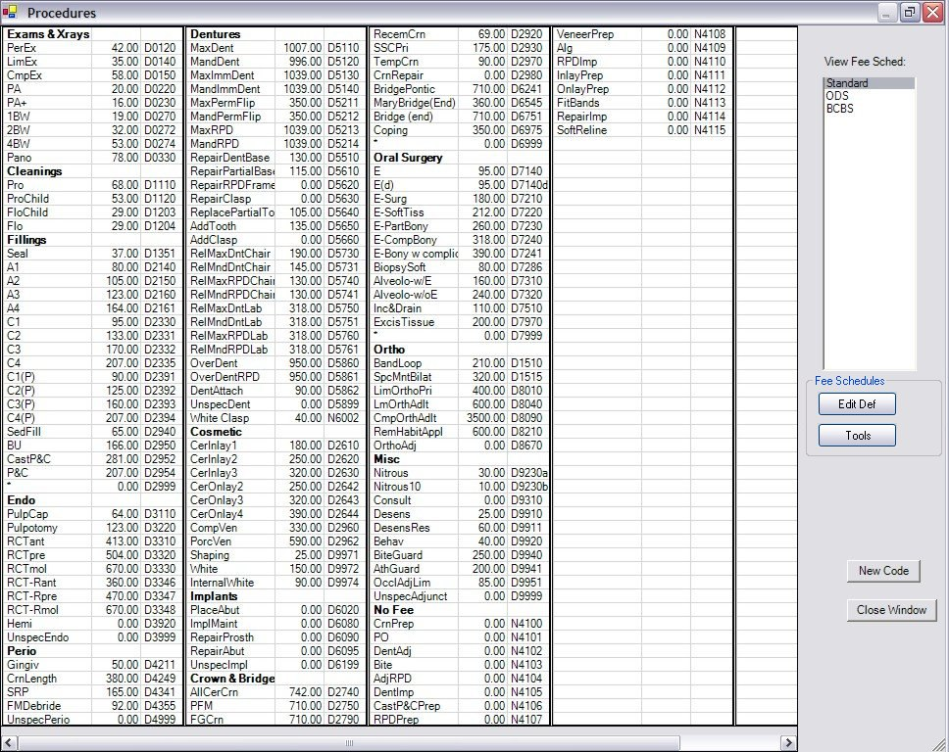
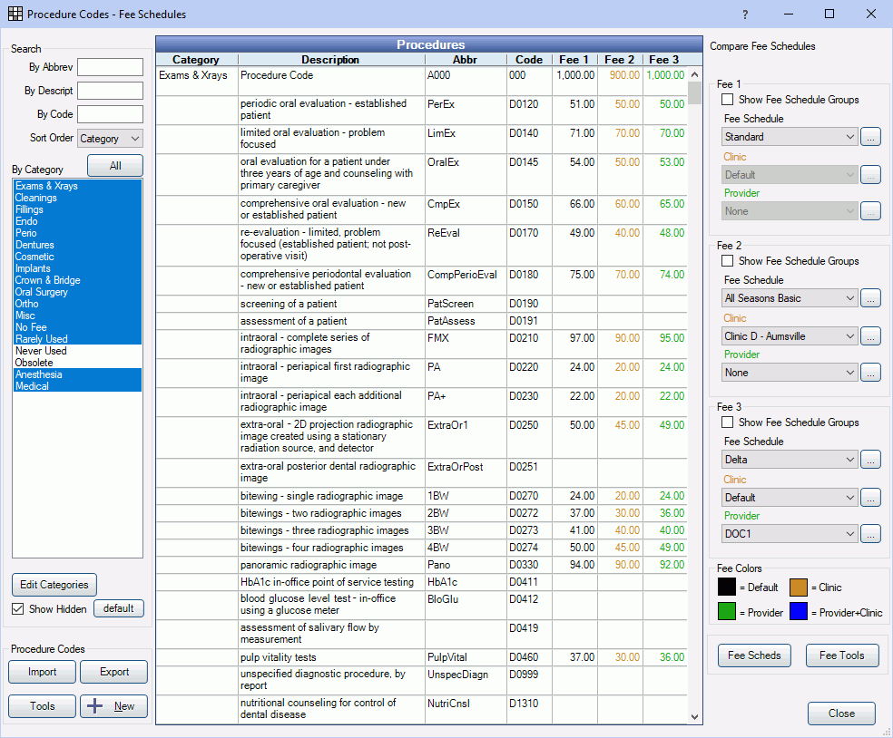
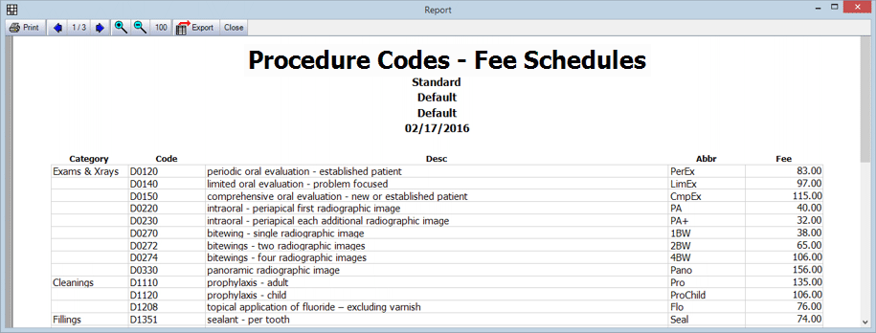
INVALID PROCEDURE CODE
I Created a table called Invalid_Procedure_Codes1
I Combined dbo.['526_Claims$'] with dbo.['Fact_Procedurelog-526$'] based on PatNum and PatNum_SrrKey and then combined both of those with dbo.['Rejected Claims$'] Date of Service
Then I found the distinct codenum
SELECT dbo.['Fact_Procedurelog-526$'].ProcNum,dbo.['Fact_Procedurelog-526$'].CodeNum
INTO Invalid_Procedure_Codes1
FROM dbo.['526_Claims$']
INNER JOIN dbo.['Fact_Procedurelog-526$']
ON
dbo.['526_Claims$'].[PatNum] = dbo.['Fact_Procedurelog-526$'].PatNum
AND
dbo.['526_Claims$'].[PatNum_SrrKey] = dbo.['Fact_Procedurelog-526$'].PatNum_SrrKey
INNER JOIN dbo.['Rejected Claims$']
ON
dbo.['Rejected Claims$'].[Date of Service] = dbo.['526_Claims$'].[DateService]
WHERE "Rejected Reason" = 'INVALID PROCEDURE CODE';
SELECT DISTINCT("CodeNum"), COUNT("CodeNum")
FROM Invalid_Procedure_Codes1
GROUP BY "CodeNum"
ORDER BY COUNT("CodeNum") DESC;

Slide 9
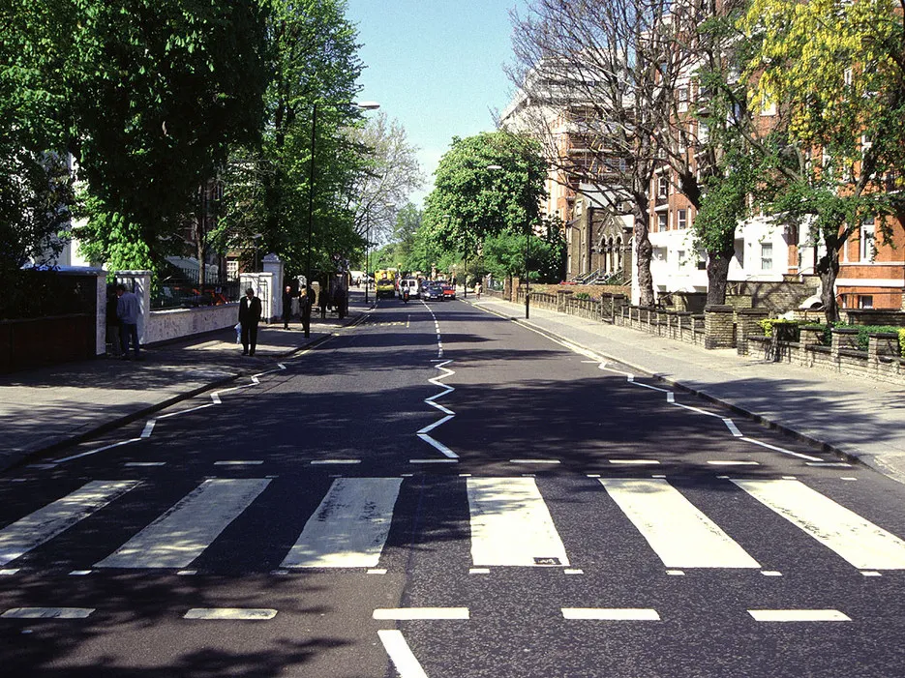


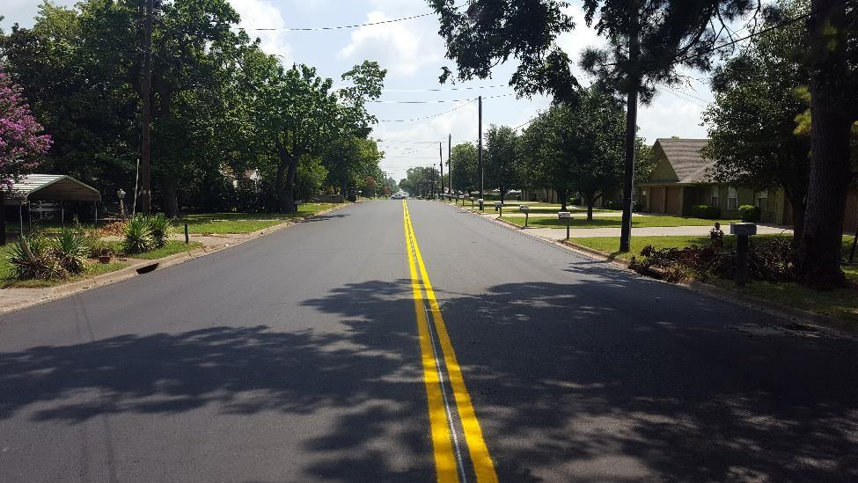
INSURED STREET REQUIRED
Combined dbo.['Rejected Claims$'] and dbo.['526_Patients$']
Combined the rejected_claims data with the 526_Patients data based on the patient name
Found the addresses where there needs to be an insured street
937 Euharlee Road SW
22 Tamassee Lane NW
18 A Joree Road
N/A
In our model when somebody has these insured streets we want to make sure these claims get rejected

Slide 10


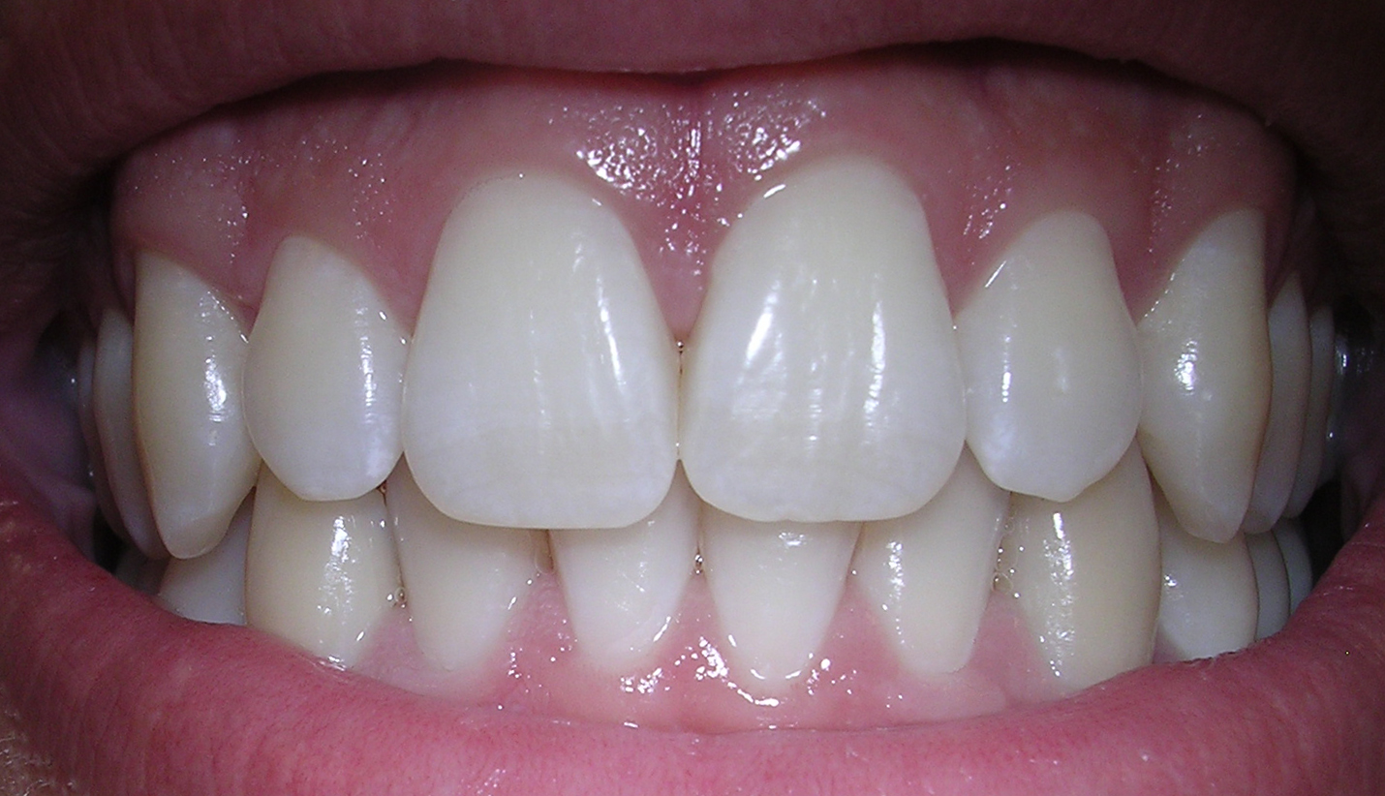
THE PROCEDURE CODE REQUIRES A TOOTH
I Created a table called NewCodes10
I Combined dbo.['526_Claims$'] with dbo.['Fact_Procedurelog-526$'] based on PatNum and PatNum_SrrKey
I Combined both of these tables with dbo.['Rejected Claims$'] based on Date of Service
Getting specific codenumber to see which codenumbers require a tooth
SELECT dbo.['Fact_Procedurelog-526$'].ProcNum,dbo.['Fact_Procedurelog-526$'].CodeNum
INTO NewCodes10
FROM dbo.['526_Claims$']
INNER JOIN dbo.['Fact_Procedurelog-526$']
ON
dbo.['526_Claims$'].[PatNum] = dbo.['Fact_Procedurelog-526$'].PatNum
AND
dbo.['526_Claims$'].[PatNum_SrrKey] = dbo.['Fact_Procedurelog-526$'].PatNum_SrrKey
INNER JOIN dbo.['Rejected Claims$']
ON
dbo.['Rejected Claims$'].[Date of Service] = dbo.['526_Claims$'].[DateService]
WHERE "Rejected Reason" = 'PROCEDURE CODE REQUIRES A TOOTH';
SELECT DISTINCT("CodeNum"), COUNT("CodeNum")
FROM NewCodes10
GROUP BY "CodeNum"
ORDER BY COUNT("CodeNum") DESC;

Slide 11



Subscriber and Subscriber ID not found
Combined dbo.['Rejected Claims$'] and dbo.['526_Patients$']
#Guarantor -1 means blank no subscriber buying the policy so the scubscriber and subscriber id is not found when Guarantor = -1
SELECT dbo.['Rejected Claims$']."Patient Name", dbo.['526_Patients$'].Guarantor, dbo.['Rejected Claims$']."Rejected Reason", dbo.['Rejected Claims$']."Tax ID", dbo.['Rejected Claims$']."Date of Service",dbo.['Rejected Claims$']."Created",dbo.['526_Patients$'].PatNum, dbo.['Rejected Claims$']."Rendering Provider"
FROM dbo.['Rejected Claims$']
INNER JOIN dbo.['526_Patients$'] ON dbo.['Rejected Claims$']."Patient Name"= dbo.['526_Patients$'].NewName3
WHERE "Rejected Reason" = 'SUBSCRIBER AND SUBSCRIBER ID NOT FOUND';

Slide 12
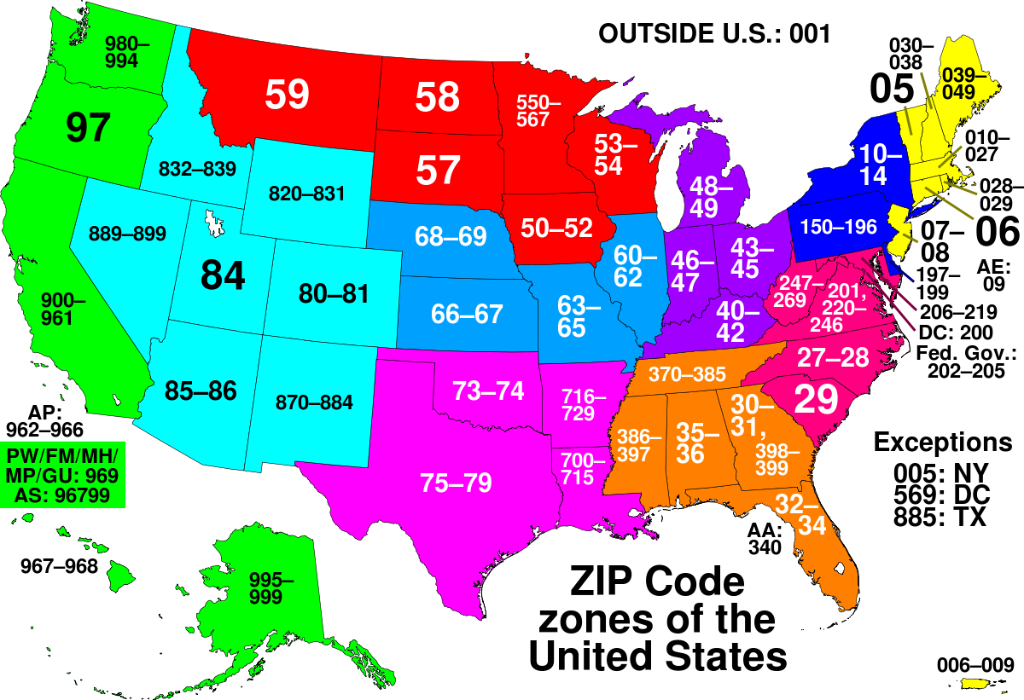
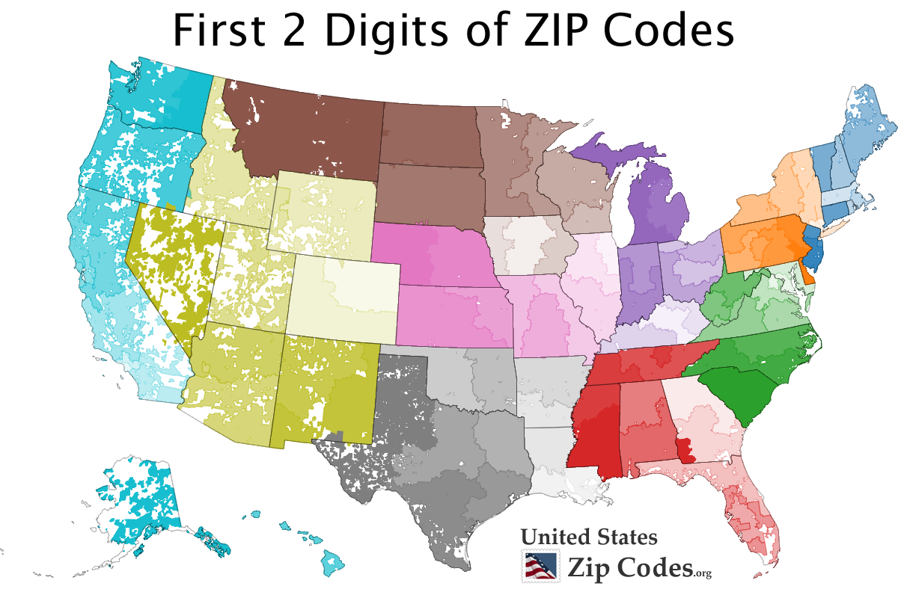
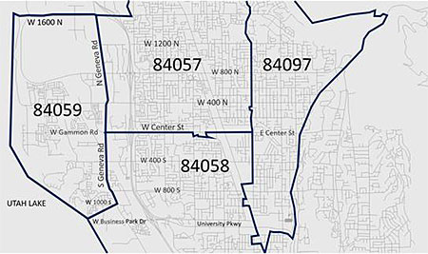
Insured Zip Invalid
Getting info from the rejected claims
Joining the rejected claims with 526_Patients data based on patients name
SELECT dbo.['Rejected Claims$']."Patient Name", dbo.['526_Patients$'].Zip
FROM dbo.['Rejected Claims$']
INNER JOIN dbo.['526_Patients$'] ON dbo.['Rejected Claims$']."Patient Name"= dbo.['526_Patients$'].NewName3
WHERE "Rejected Reason" = 'INSURED ZIP INVALID';
JONES,JUSTIN 30165
Justin Jones with zip code 30165 is the only invalid zip code

Slide 13
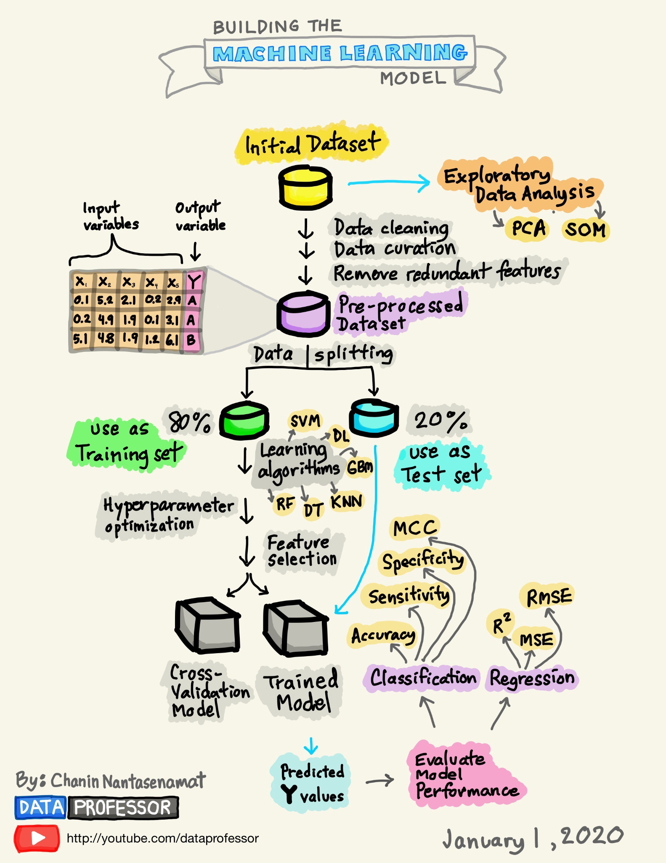
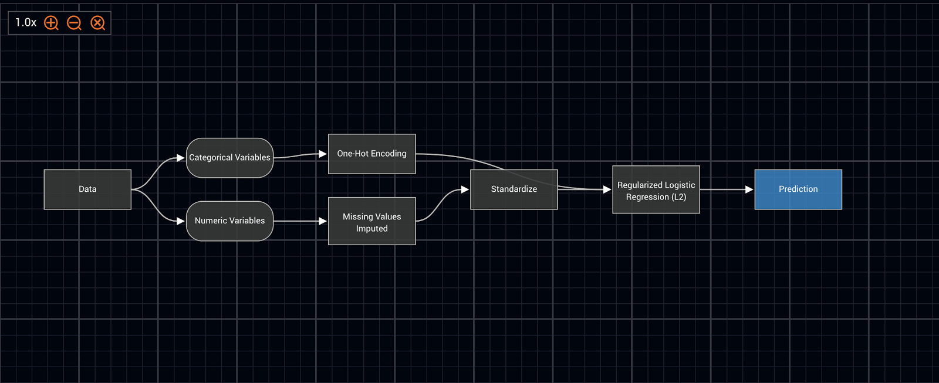
Machine Learning Models
Our problem: Classification problem- want to classify claims as either rejected or not rejected
In order to do this we use machine learning models in SQL using R programming
Machine learning uses input data to predict output values
Finds patterns and make predictions
Machine Learning is mainly used for classification and regression tasks:
Classification tasks: predicting a discrete class label
Regression tasks: predicting continuous quantity

Slide 14
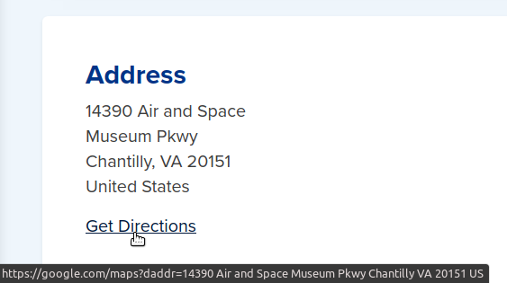
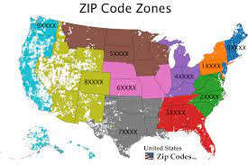
Blueprint for Machine Learning Models
My initial blueprint consists of all the data from dbo.[‘526_Claims’]
We then want to combine it with the ProcNum and CodeNum from dbo.['Fact_Procedurelog-526$'] since those columns are part of rejection reasons
We also want Address, Zip, and Guarantor from dbo.[‘526_Patients’] since those columns are important for rejected reasons
One of the datasets will be joined to the rejected claims data the other will not
We will then combined these two datasets together to make one dataset
Then split dataset into training and testing

Slide 15
Blueprint for Machine Learning Models
Initial dataset- dbo.[‘526 Claims’]
/ \
Claims that are rejected: Claims that are not rejected
Combine with dbo.[‘Rejected Claims’]
| /
Combine with:
dbo.['526_Patients$']
/ \ |
Address Zip Guarantor
|

Slide 16
Blueprint for Machine Learning Models (Part 2)
Combine with:
dbo.['Fact_Procedurelog-526$']
/ \
CodeNum ProcNum
Run machine learning model on training dataset to predict testing
|
Based on models performance- try to improve accuracy
| | |
Remove outliers Feature selection I.V. oversampling
/ \ W.O.E / \
earth correlation Traditional oversampling algorithms
/ \
ROSE SMOTE

Slide 17
Code for datasets Part 1
;WITH YourAlias AS (
SELECT dbo.['526_Claims$'].*,dbo.['Fact_Procedurelog-526$'].ProcNum,dbo.['Fact_Procedurelog-526$'].CodeNum,dbo.['526_Patients$'].Address,dbo.['526_Patients$'].Zip,dbo.['526_Patients$'].Guarantor,dbo.['Rejected Claims$'].Rejected
FROM dbo.['526_Claims$']
INNER JOIN dbo.['Rejected Claims$']
ON dbo.['526_Claims$'].DateService = dbo.['Rejected Claims$'].[Date of Service]
INNER JOIN dbo.['526_Patients$']
ON
dbo.['Rejected Claims$']."Patient Name"= dbo.['526_Patients$'].NewName3
INNER JOIN dbo.['Fact_Procedurelog-526$']
ON
dbo.['526_Claims$'].[PatNum] = dbo.['Fact_Procedurelog-526$'].PatNum
AND
dbo.['526_Claims$'].[PatNum_SrrKey] = dbo.['Fact_Procedurelog-526$'].PatNum_SrrKey),

Slide 18
Code for Datasets Part 2
MyAlias AS (
SELECT dbo.['526_Claims$'].*,dbo.['Fact_Procedurelog-526$'].ProcNum,dbo.['Fact_Procedurelog-526$'].CodeNum,dbo.['526_Patients$'].Address,dbo.['526_Patients$'].Zip,dbo.['526_Patients$'].Guarantor
FROM dbo.['526_Claims$'] )
NNER JOIN dbo.['Fact_Procedurelog-526$']
ON
dbo.['526_Claims$'].[PatNum] = dbo.['Fact_Procedurelog-526$'].PatNum
AND
dbo.['526_Claims$'].[PatNum_SrrKey] = dbo.['Fact_Procedurelog-526$'].PatNum_SrrKey
INNER JOIN dbo.['526_Patients$']
ON
dbo.['526_Patients$'].[PatNum] = dbo.['Fact_Procedurelog-526$'].PatNum
AND
dbo.['526_Patients$'].[PatNum_SrrKey] = dbo.['Fact_Procedurelog-526$'].PatNum_SrrKey
WHERE ClaimNum_SrrKey NOT IN (SELECT ClaimNum_SrrKey FROM YourAlias) ),

Slide 19
Code for Datasets Part 3
Combined_Dataset AS(
SELECT *
FROM YourAlias
UNION ALL
SELECT *
FROM MyAlias3)

Slide 20
Blueprint for Datasets
Why do we split into X and Y?
X is known as features or the independent variables. Y is known as label or dependent variable. We split into X and Y so we will be able to predict the labels of new features without the label currently being present.
Objective: to predict whether a new claim will get Rejected/Not Rejected and the probability of Rejection/Not Rejection

Slide 21
Blueprint for Machine Learning Models
Original Dataset
Y: Rejected Column- 1st row of X corresponds with 1st row of Y, 2nd row of X corresponds with 2nd row of Y, and so on and so forth.
Dummy Data:
X: columns of original dataset: ClaimNum_SrrKey, ClaimNum, PatNum_SrrKey, PatNum, ProvNum_SrrKey, ProviderNum, InsPayEst, InsPayAmt, DedApplied, AttachmentID, PrimCarrierNum_Srrkey, PrimCarrierNum, PrimResponsibleNum, Is_Deleted, ProcNum, Zip, Guarantor
Train
Test
Test
Train

Slide 22
Columns present in the Dataset
ClaimNum_SrrKey,
ClaimNum,
PatNum_SrrKey
PatNum
ProvNum_SrrKey
ProviderNum
InsPayEst
InsPayAmt
DedApplied
AttachmentID
PrimCarrierNum_Srrkey
PrimCarrierNum
PrimResponsibleNum
Is_Deleted
ProcNum
Zip
Guarantor

Slide 23


What is machine learning and artificial intelligence?
Artificial Intelligence (AI) refers to a branch of computer science that concerns with building machines that are able to do tasks that require human intelligence
These machines can improve themselves based on information they collect
AI is normally put into 3 categories:
Narrow AI- the type of Artificial Intelligence (AI) that exists in our world today. Also known as weak AI. This type of AI is used to perform a single task such as playing chess or checking the weather.
Artificial General Intelligence (AGI)- can perform any task a human can with greater proficiency but can’t perform any tasks not given to them- does not exist
Artificial Super Intelligence (ASI) - machines can surpass the capacity of human intelligence and behavioral ability- does not exist
Machine Learning branch of artificial intelligence- systems can learn from data, identify patterns, and make decisions- minimal human intervention

Slide 24
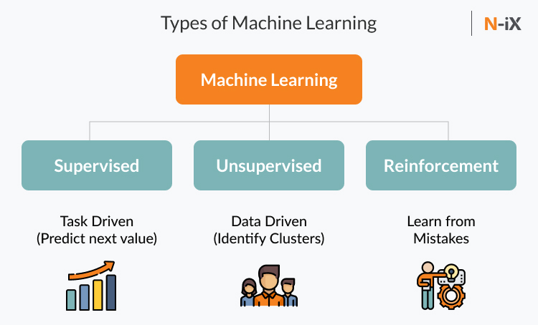
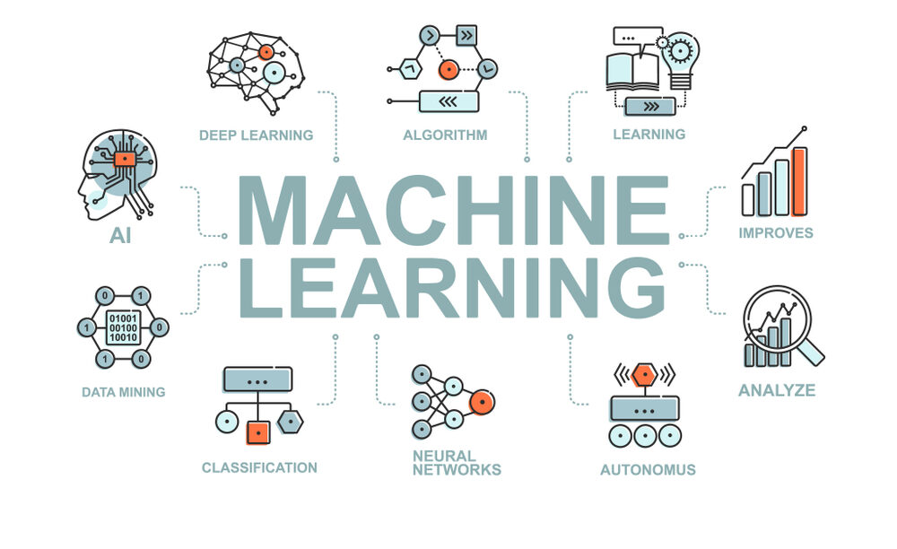
What is machine learning?
Humans can train machines to learn from past data
Using statistics and computer science to enable computer to do a given task
Computers are given the capacity to learn without being explicitly programmed to do so
Machine Learning algorithms are classified into 4 types: Supervised Learning, Unsupervised Learning, Semi-supervised Learning, and Reinforcement Learning:
Supervised Learning- machine learns by example: Classification, Regression, and Forecasting
Clasiification- machine learning program looks at observed values and determine which categories new observations belong.
Regression - machine learning program estimates and understands relationships among variables
Forecasting - making predictions on the future based on past and present data
Unsupervised Learning - used to analyze and cluster unlabeled data
SemiSupervised Learning - uses both labeled and unlabeled data to train a model
Reinforcement Learning- based on interactions with the environment the machine takes actions that

Slide 25

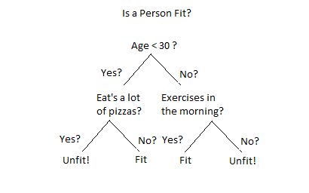
What is Random Forest?
Decision tree example 2
RandomForest is made up of multiple decision trees
What is a decision tree?
Decision tree data is split according to a common parameter
The decision tree consists of nodes and leaves the nodes are the questions that split up the tree and the leaves are the answers and probability
Two examples of decision trees: decision tree example 1, decision tree example 2
Example of nodes in decision tree examples for decision tree example 1: Age<30, Eat a lot of pizzas, Exercises in the morning? And the leaves are Fit and Unfit.
Example of nodes in decision tree example 2: is sex male?, is age > 9.5?, is sibsp > 2.5? And the leaves are : died and survived and the probability based on the condition
Decision tree example 1

Slide 26

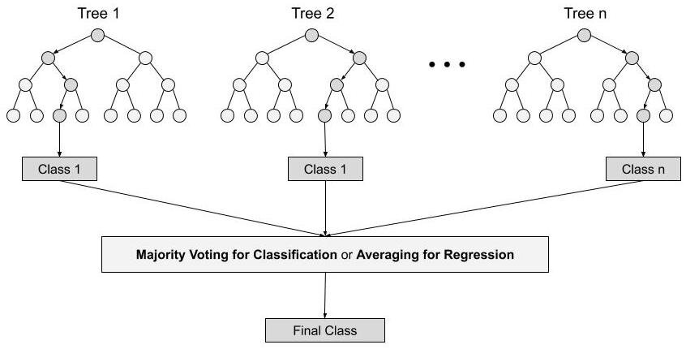
What is Random Forest? (part 2)
RandomForest takes a vote among samples and chooses majority vote for classification and average vote for regression
RandomForests normally do not suffer from overfitting (memorizing the training dataset) which decision trees normally encounter
RandomForest is normally slower than decision trees

Slide 27
Connect to R
Wanted to run an R server to connect to SQL to run our ranomForest model
Access the combined dataset made earlier
Split my data into 70, 30 split
Removed NA values from train and test
Remove all non character columns from dataset
Ran randomForest got almost 100% accuracy
Be able to predict probability whether a claim will get rejected

Slide 28
Connect to SQL from R code
connStr <- paste("Driver=SQL Server; Server=", "DESKTOP-J13R6DU\\SQLEXPRESS",";Database=", "BPK_TECH", ";Trusted_Connection=true;", sep = "");
SQL_testdata <- RxSqlServerData(table = "dbo.Combined_Dataset2_3",connectionString = connStr, returnDataFrame = TRUE);
data2 <- rxImport(SQL_testdata)
dt = sort(sample(nrow(data2), nrow(data2)*.7))
train<-data2[dt,]
test<-data2[-dt,]
train <- train[complete.cases(train),]
train$Rejected <- as.factor(train$Rejected)
test <- test[complete.cases(test),]
test$Rejected <- as.factor(test$Rejected)
new_train <- train[, !sapply(train, is.character)]
new_test <- test[, !sapply(test, is.character)]
library(randomForest)
model_rf <- randomForest(Rejected ~.,data = new_train)
predict_rf <- predict(model_rf, new_test, type = "prob")
print(predict_rf)

Slide 29
Connect to SQL from R function
}
RandomForestpredict2 <- function(dataset){
connStr <- paste("Driver=SQL Server; Server=", "DESKTOP-J13R6DU\\SQLEXPRESS",";Database=", "BPK_TECH", ";Trusted_Connection=true;", sep = "");
SQL_testdata <- RxSqlServerData(table = "dbo.Combined_Dataset2_3",connectionString = connStr, returnDataFrame = TRUE);
data2 <- rxImport(SQL_testdata)
train <- data2[, !sapply(data2, is.character)]
dataset2 <- dataset[, !sapply(dataset, is.character)]
library(randomForest)
model_rf <- randomForest(Rejected ~.,data = train)
predict_rf <- predict(model_rf, dataset2, type = "prob")
print(predict_rf)
}

Slide 30
Connect to Python
In order to test new (dummy data) switched to using Python
Wanted to use sklearn and RandomForestClassifier() to predict the probability whether new data will get Rejected/Not Rejected and whether the new data will get Rejected/Not Rejected
Not present in R
Split x and y x is columns of the original dataset and y contains the rejected column first row of x corresponds with first entry of y, second row of x corresponds with second entry of y, and so on and so forth…
Created a function to get probability of any new rejected claim working for csv file

Slide 31
Connect to SQL from Python code
import pandas as pd
import numpy as np
import pyodbc
from sklearn.ensemble import RandomForestClassifier
from sklearn.model_selection import train_test_split #for split the data
conn = pyodbc.connect('Driver={SQL Server};'
'Server=DESKTOP-J13R6DU\SQLEXPRESS;'
'Database=BPK_TECH;'
'Trusted_Connection=yes;')
df = pd.read_sql_query('SELECT * FROM dbo.Combined_Dataset2_3', conn)
x = df.drop(columns = ['Rejected'])
x = x.select_dtypes(['number'])
print(x.head())
y = df['Rejected']
x_train, x_test, y_train, y_test = train_test_split(x,y, test_size=0.3, random_state=2)
random_forest_model = RandomForestClassifier()
random_forest_model.fit(np.nan_to_num(x_train),y_train)

Slide 32
Connect to SQL from Python code (Part 2)
new_df = pd.read_excel(r'C:\Users\Sankalp Chauhan\Desktop\Sonny\BPK_TECH\Dummy Data.xlsx')
new_list = []
for n in new_df:
if n.strip() not in x:
new_list.append(n)
new_df = new_df.drop(new_list, axis = 1)
array_df = np.asarray(np.nan_to_num(new_df))
prediction_prob = random_forest_model.predict_proba(np.nan_to_num(array_df))
prediction = random_forest_model.predict(np.nan_to_num(array_df))
for i in range(len(prediction)):
print("X=%s, Predicted=%s" % (prediction[i], prediction_prob[i]))

Slide 33
Python function to Connect to SQL
def randomforest_function(dataframe):
import pandas as pd
import numpy as np
import pyodbc
from sklearn.ensemble import RandomForestClassifier
from sklearn.model_selection import train_test_split
conn = pyodbc.connect('Driver={SQL Server};'
'Server=DESKTOP-J13R6DU\\SQLEXPRESS;'
'Database=BPK_TECH;'
'Trusted_Connection=yes;')
df = pd.read_sql_query('SELECT * FROM dbo.Combined_Dataset2_3', conn)
x = df.drop(columns = ['Rejected'])
x = x.select_dtypes(['number'])
y = df['Rejected']
x_train, x_test, y_train, y_test = train_test_split(x,y, test_size=0.3, random_state=2)
random_forest_model = RandomForestClassifier()
random_forest_model.fit(np.nan_to_num(x_train),y_train)
new_list = []
new_df = pd.read_csv(dataframe)

Slide 34
Python function to connect to SQL (Part 2)
for n in new_df:
if n.strip() not in x:
new_list.append(n)
new_df = new_df.drop(new_list, axis = 1)
array_df = np.asarray(np.nan_to_num(new_df))
prediction_prob = random_forest_model.predict_proba(np.nan_to_num(array_df))
prediction = random_forest_model.predict(np.nan_to_num(array_df))
for i in range(len(prediction)):
print("X=%s, Predicted=%s" % (prediction[i], prediction_prob[i]))

Slide 35
Python function to connect to SQL with rules (Part 1)
def randomforest_function(dataframe):
import pandas as pd
import numpy as np
import pyodbc
from sklearn.ensemble import RandomForestClassifier
from sklearn.model_selection import train_test_split
conn = pyodbc.connect('Driver={SQL Server};'
'Server=DESKTOP-J13R6DU\\SQLEXPRESS;'
'Database=BPK_TECH;'
'Trusted_Connection=yes;')
df = pd.read_sql_query('SELECT * FROM dbo.Combined_Dataset2_3', conn)
x = df.drop(columns = ['Rejected'])
x = x.select_dtypes(['number'])
y = df['Rejected']
x_train, x_test, y_train, y_test = train_test_split(x,y, test_size=0.3, random_state=2)
random_forest_model = RandomForestClassifier()
random_forest_model.fit(np.nan_to_num(x_train),y_train)
new_list = []

Slide 36
Python function to connect to SQL with rules (Part 2)
new_df = pd.read_csv(dataframe)
Invalid_procedurecode_df1 = pd.read_sql_query('SELECT DISTINCT(ProcNum) FROM dbo.INVALID_PROCEDURECODES',conn)
Invalid_procedurecode_df2 = pd.read_sql_query('SELECT DISTINCT(CodeNum) FROM dbo.INVALID_PROCEDURECODES',conn)
Invalid_tooth_procedure_procnum_df = pd.read_sql_query('SELECT DISTINCT(ProcNum) FROM dbo.CodeNumbers',conn)
Invalid_tooth_procedure_codenum_df = pd.read_sql_query('SELECT DISTINCT(CodeNum) FROM dbo.CodeNumbers',conn)
Invalid_Zip_Code_df = pd.read_sql_query('SELECT * FROM dbo.Invalid_Zip_Code_Data',conn)
index_list = []
for index, row in new_df.iterrows():
if row["ProcNum"] in Invalid_procedurecode_df1:
index_list.append(index)
print(index + 1,"row in csv")
print("X=%s, Predicted=%s" % ("Rejected", "[1.00 0.00]"))
print("Rejected Reason: INVALID PROCEDURE CODE")
if row["CodeNum"] in Invalid_procedurecode_df2:
print(index + 1,"row in csv")

Slide 37
Python function to connect to SQL with rules (Part 3)
print("X=%s, Predicted=%s" % ("Rejected", "[1.00 0.00]"))
print("Rejected Reason: INVALID PROCEDURE CODE")
if index not in index_list:
index_list.append(index)
if row['ProcNum'] in Invalid_tooth_procedure_procnum_df:
print(index + 1,"row in csv")
print("X=%s, Predicted=%s" % ("Rejected", "[1.00 0.00]"))
print("Rejected Reason: PROCEDURE CODE REQUIRES A TOOTH")
if index not in index_list:
index_list.append(index)
if row['CodeNum'] in Invalid_tooth_procedure_codenum_df:
print(index + 1,"row in csv")
print("X=%s, Predicted=%s" % ("Rejected", "[1.00 0.00]"))
print("Rejected Reason: PROCEDURE CODE REQUIRES A TOOTH")
if index not in index_list:
index_list.append(index)
if row['Zip'] in Invalid_Zip_Code_df:
print(index + 1,"row in csv")
print("X=%s, Predicted=%s" % ("Rejected", "[1.00 0.00]"))
print("Rejected Reason: INSURED ZIP INVALID")
if index not in index_list:
index_list.append(index)
new_df = new_df.drop(index_list)
for n in new_df:
if n.strip() not in x:
new_list.append(n)
new_df = new_df.drop(new_list, axis = 1)
array_df = np.asarray(np.nan_to_num(new_df))
prediction_prob = random_forest_model.predict_proba(np.nan_to_num(array_df))
prediction = random_forest_model.predict(np.nan_to_num(array_df))
for i in range(len(prediction)):
print("X=%s, Predicted=%s" % (prediction[i], prediction_prob[i])

